Slide 1

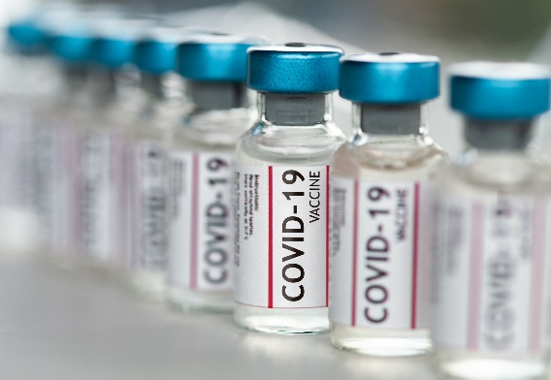
Covid-19 Vaccine Types and Efficiency
Supraja Rapuru

Slide 2
Agenda
Executive Summary
Vaccine Administration by Vaccine Type
Vaccine Efficacy
Vaccine Adverse Effects
Vaccine Distribution by State/Jurisdiction
Q&A

Slide 3
Executive Summary
Moderna’s vaccine uses 100 micrograms of RNA per dose, while Pfizer-BioNTech’s shot uses only 30 micrograms making it easier to produce and less expensive. That should enable Pfizer-BioNTech to increase production of their vaccine more quickly than Moderna which is evident pfizer vaccinated population is more than others in USA
The vaccines developed by Pfizer-BioNTech and Moderna take advantage of messenger RNA (mRNA), which instructs cells to produce a protein on the surface of the virus. The immune system recognizes those vaccine-triggered spike proteins as invaders and creates antibodies to block future attacks of the virus that causes COVID-19. As we hear in recent months blood clot events in case of Janaseen, vaccines based on RNA could have more acceptance rate by the population in USA
Public health experts emphasize that all the vaccines are effective, particularly at preventing serious disease. Because trials were conducted differently at different times, effectiveness figures cannot be directly compared
COVID-19
COVID-19
COVID-19
Vaccine
Vaccine
Vaccine
Pfizer
Moderna
Janaseen

Slide 4
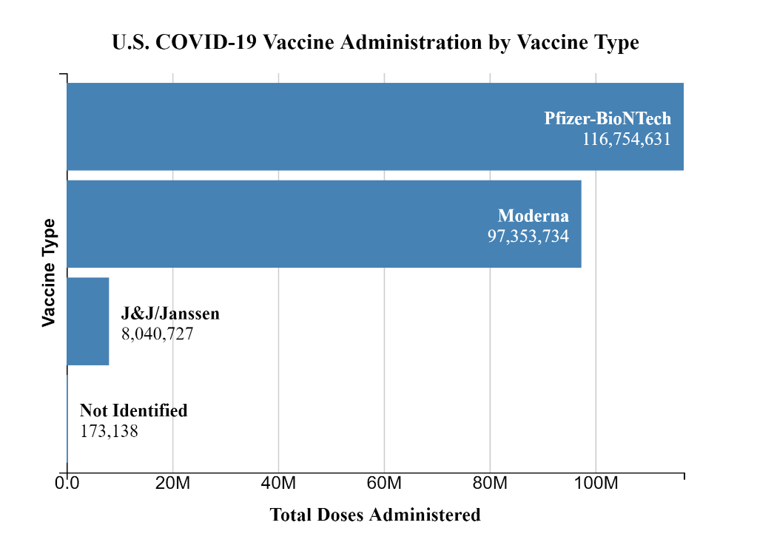
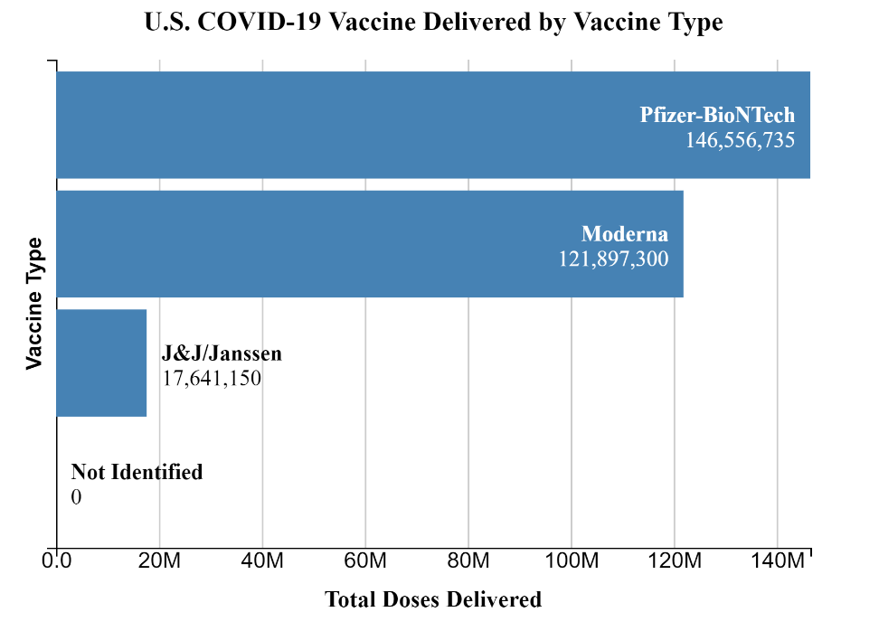
U.S. COVID-19 Vaccine Administration by Vaccine Type: Source CDC
As per the data published by CDC as of April 23rd 2021 8PM ET(https://covid.cdc.gov/covid-data-tracker/#vaccinations) , Pfizer vaccines numbers are high comparatively to Moderna and Janaseen however just by looking at these administered numbers, we can not conclude that Pfizer is more popular. The production/availability of these to the states seems playing a bigger role. As per the second chart Pfizer has got more doses delivered, that explains why we see pfizer is widely administered vaccine in USA.

Slide 5
U.S. COVID-19 Vaccine Efficacy: Source CDC
As per the clinical trails done by the respective vaccine companies and also as quoted by Dr. Linda Bell, State Epidemiologist for South Carolina's Department of Health and Environmental Control in an interview with WCNC, it is unfair to compare vaccine efficacy from scientific stand point as they were tested in different points in time. They were tested in different populations of people when there were different strains circulating in those different populations of people.

Slide 6

U.S. COVID-19 Vaccine Efficacy: Source FDA
FDA briefing links:
Pfizer-BioNTech, published on Dec 10,2020, https://www.fda.gov/media/144245/download
Moderna, published on Dec 17, 2020, https://www.fda.gov/media/144434/download
Janaseen, published on Feb 26, 2021, https://www.fda.gov/media/146217/download
As per the FDA briefing dates, it is evident that the testing done possibly on different strains circulating in those different populations of people. So comparison is not fair.
 | Pfizer | Moderna | Janaseen
Characteristics | mRNA 30micrograms/dose 2 doses 43,448 in trail | mRNA 100micrograms/dose 2 doses 30,400 in trail | ADENOVIRUS 1 dose 40,000 in trail
Overall Efficacy | 94.6% after dose2 7days after dose2 | 94.5% after dose2 14days after dose2 | 66.9% after dose 28days after dose
Covid related death prevention | 100% protection 2 deaths in vaccine group but no data if they are vaccine related | 100% protection No reports of deaths in vaccine group 1 death in placebo | 100% protection No reports of deaths in vaccine group 7 deaths in placebo

Slide 7
U.S. COVID-19 Vaccine Adverse Effects : Source FDA
 | Pfizer | Moderna | Janaseen
Clotting | No | No | 15 versus 10 (vaccinate vs not vaccinated)
Tinnitus | No | No | 6 versus 0
Bell’s Palsy | 4 versus 0 | 3 versus1 | 2 versus 2
Anaphylaxis | None observed | None Observed | None Observed
Common side Affects | Chills, headache, pain, tiredness, and/or redness and swelling at the injection site | Chills, headache, pain, tiredness, and/or redness and swelling at the injection site | Fatigue, fever headache, injection site pain, or myalgia (pain in a muscle or group of muscles)
FDA briefing links:
Pfizer-BioNTech, published on Dec 10,2020, https://www.fda.gov/media/144245/download
Moderna, published on Dec 17, 2020, https://www.fda.gov/media/144434/download
Janaseen, published on Feb 26, 2021, https://www.fda.gov/media/146217/download
Please note these numbers from trails done not the actual people vaccinated as of today. By looking at the numbers, it is difficult to decide which to chose when you have an option. Instead i believe you should take vaccine which ever is available in your area to combat the severe infection.

Slide 8
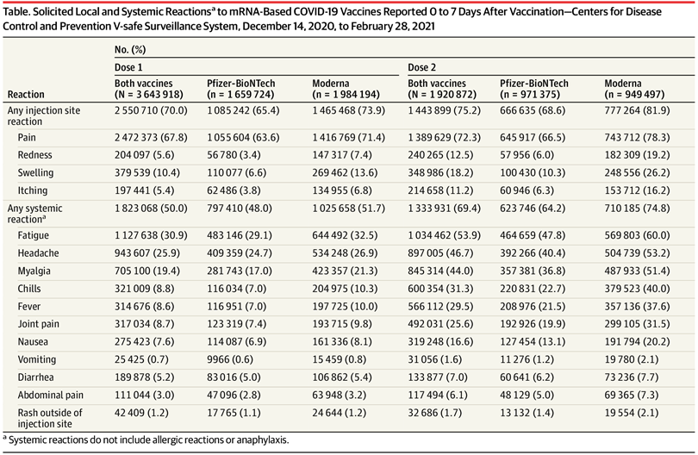
U.S. COVID-19 Vaccine Adverse Effects - Pfizer vs Moderna
Individuals who receive the Moderna vaccine are more likely to experience post-vaccine reactions and side effects, new data from the U.S. Centers for Disease Control and Prevention (CDC) show (table).
A greater percentage of participants who received the Moderna vaccine, compared with the Pfizer-BioNTech vaccine, reported reactogenicity; this pattern was more pronounced after the second dose.
Source: Published in the online journal JAMA

Slide 9
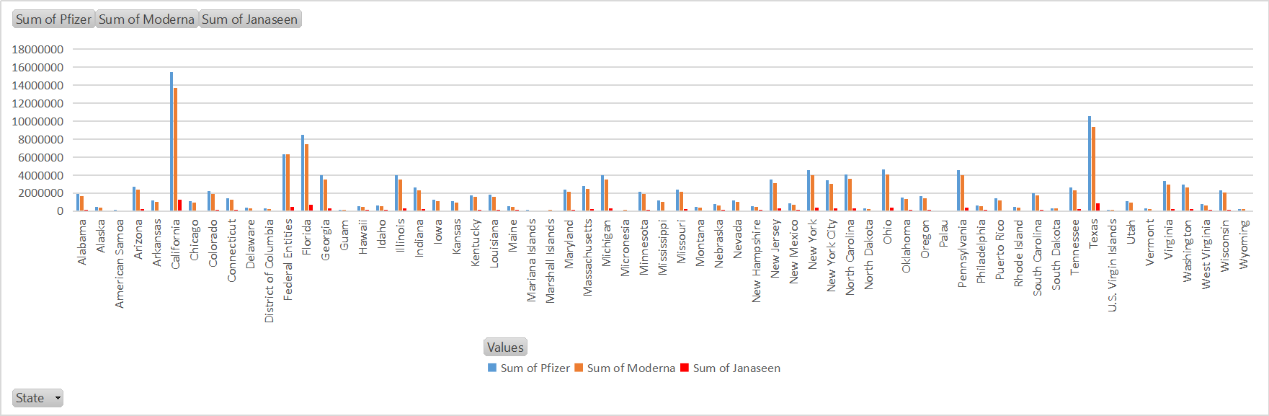
US Covid-19 Vaccine Distribution by State/Jurisdiction
Vaccine Distribution by types and by States
Vaccine Distribution Start Dates
Data Source downloaded: CDC.Data.gov
Pfizer and Moderna are distributed to states by federal government hence you see the # of people vaccinated with Pfizer and Moderna are more. Pfizer distribution started on 12/14/2020, Moderna on 12/21/2020 where as Janaseen is March 2021. Also news about blood clotting events for Janaseen has kept the distribution on hold.
Between Pfizer and Moderna, Pfizer has more numbers and make it popular. Perhaps severe side effects of Moderna after 2nd dose might have directed people to prefer Pfizer more.

Slide 10
Q&A

